Slide 1
Photo-detector IR and Vis
MEMS device
Zachary Luscher, Jennifer Padilla
Notes:
Working principle
,
Design Constraints, Selection of Materials, Selection of Manuf.
Processes, Transduction mechanism

Slide 2
Introduction
-Currently there are two types of detectors
-Photon detectors have good performance and short response
-Thermal detectors are able to work under a variety of temperatures
Notes:
Thermal and photon
Thermal consists of Infrared radiation being absorbed and converted into thermal energy
Photon consists of using change the state of semiconductor materials when detector absorbs photons which result in photovoltaic

Slide 3
Design Constraints
Must produce signal from electromagnetic sources
Must be encased in less than 5mm radius package
Photoelectric effect limited for IR spectrum due to johnson noise.
Process Techniques are limited by Etchants and Stiction
Notes:
Two types of IR sensors thermal and photon
Photons are limited due to the impact of noise from higher ambient temperatures and need for cooling systems limits their current applications

Slide 4
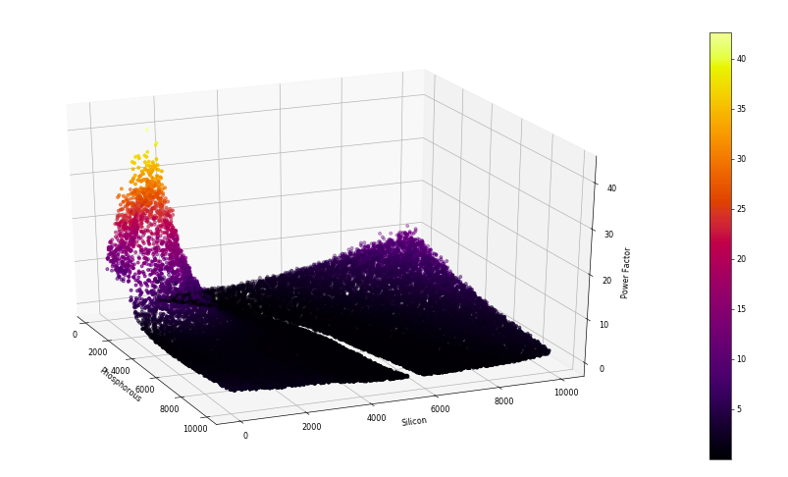

Selection of Material -Infrared Sensor
-To optimize figure of merit
Low thermal conductivity
High electrical conductivity
High seebeck coefficient

Slide 5
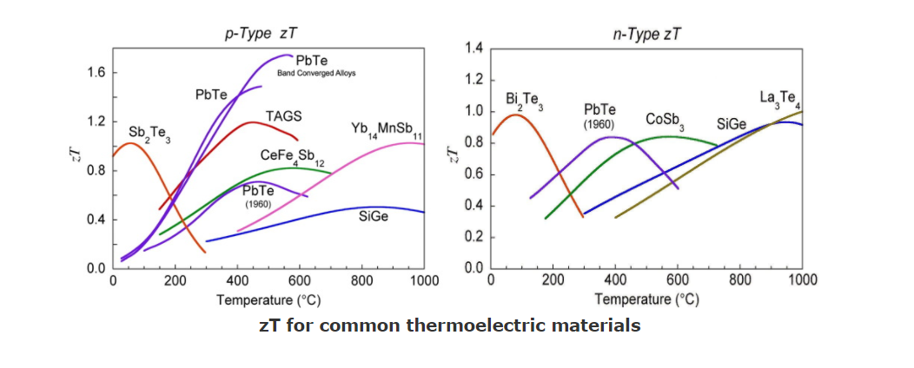
Kasper A. Borup, Johannes de Boor, Heng Wang, Fivos Drymiotis, Franck Gascoin, Xun Shi, Lidong Chen, Mikhail I. Fedorov, Eckhard Müller, Bo B. Iversen, G. Jeffrey Snyder “Measuring Thermoelectric Transport Properties of Materials” Energy and Environmental Science 8, 423 (2015)

Slide 6
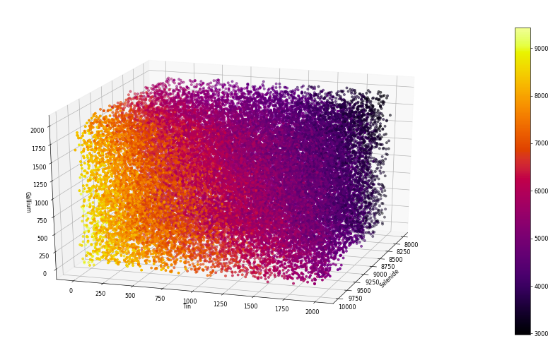

Slide 7
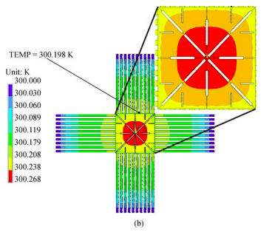
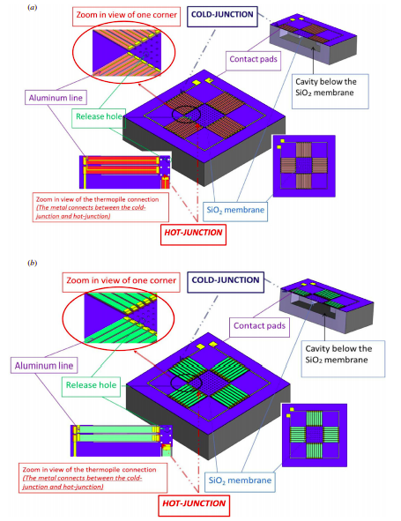
Selection of Manufacturing Process - Infrared
{1]
Notes:
The etching windows cut off the heat transfer path from the absorber to the hot junctions; (b) the etching windows avoid cutting off the heat transfer path from the absorber to the hot junctions

Slide 8
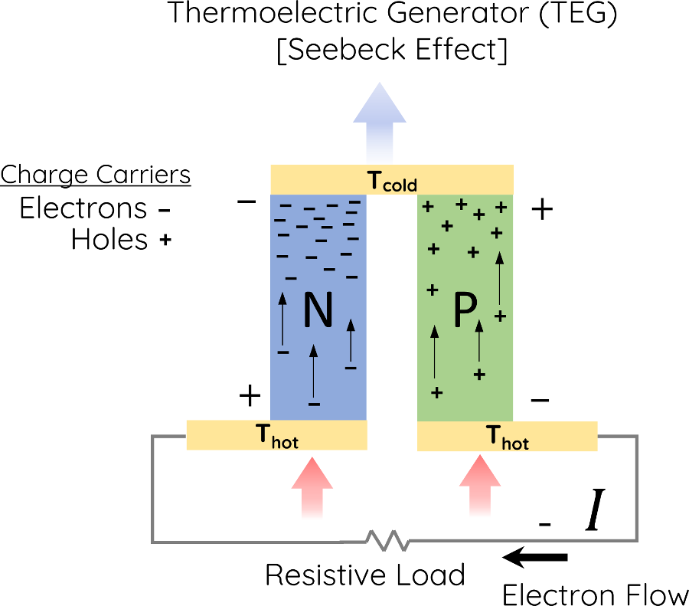
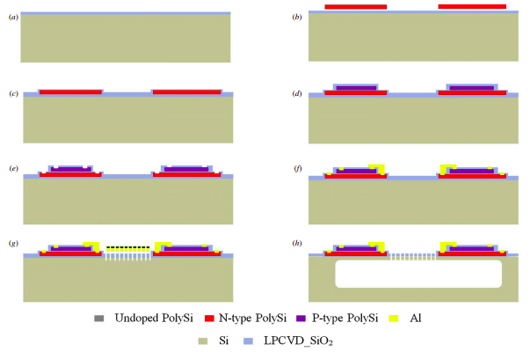
Absorber
T Hot
Thermal Isolating Cavity
T Cold
Notes:
Indium p type antimony n type BiTe InCoSb CuSe
Boron p type Phosphorus n type Silicon

Slide 9
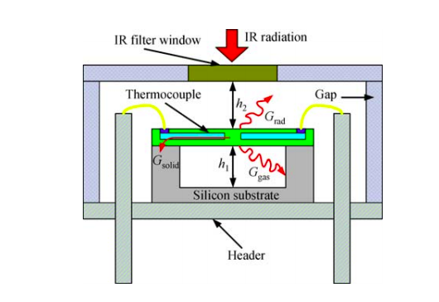
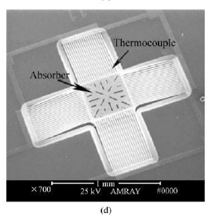
Notes:
Thus, front-side etching thermoelectric IR sensors usually show poor performance. However, combining back-side etching and front-side etching can improve the sensor performance twice as high as that of front-side etching alone

Slide 10
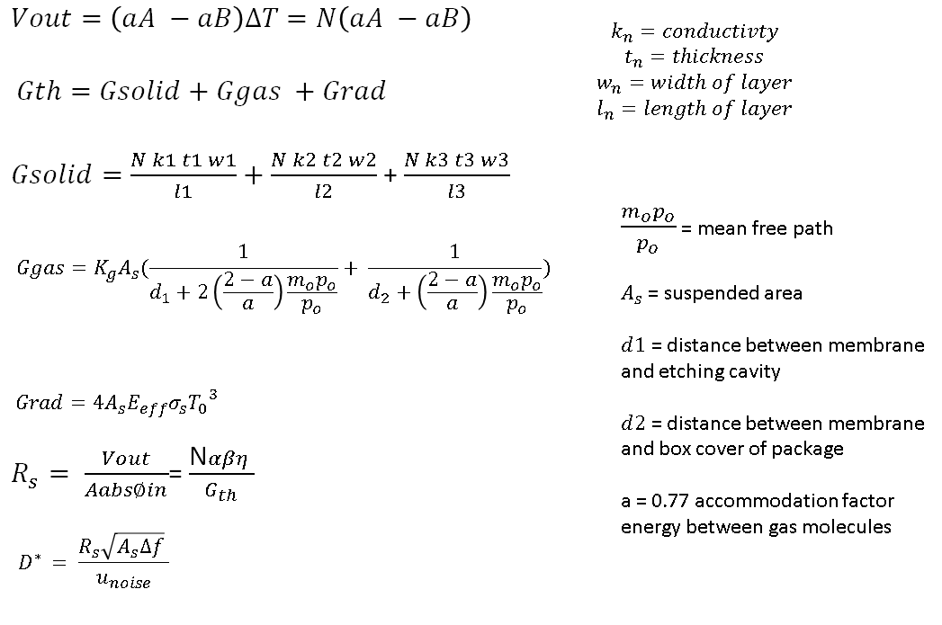
Seebeck Effect
Thermal Losses
Constants
Notes:
Seebeck effect

Slide 11
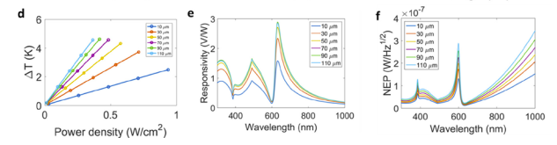

Slide 12
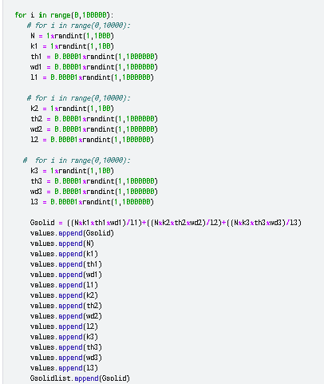
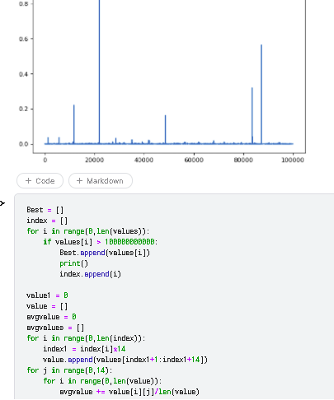

Slide 13
Micro-Physical Constraints for Optimization
Maximize the Temperature difference
Maximize distance between casing and device
Maximize suspended area
Maximize width and thickness relative to length while maintaining a larger number of thermocouples
Notes:
Maximize ∆T
Maximize Gth
Maximize width and thickness relative to length while maintaining greatest number of thermophiles
Maximize suspended Area
Minimize distance between casing and device
Maximize Seebeck coefficient

Slide 14
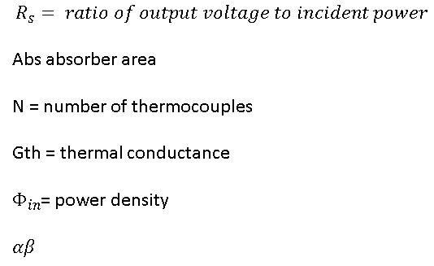
Responsivity
Detectivity
Constants

Slide 15
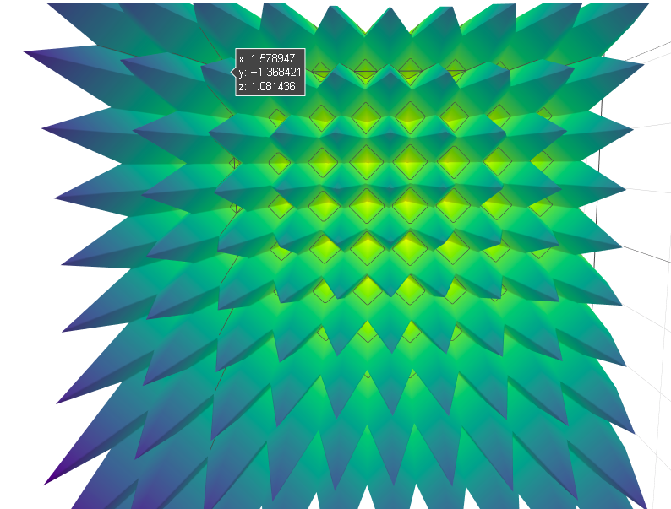
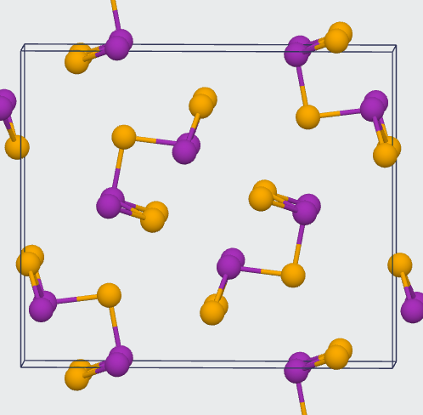
INFRARED
ELECTRON

Slide 16
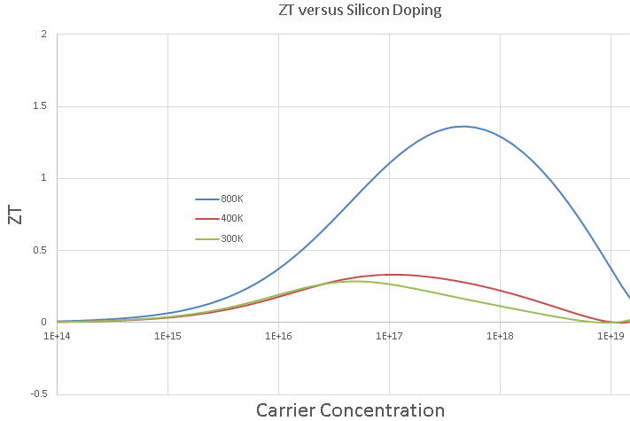
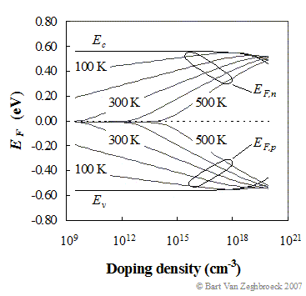

Slide 17
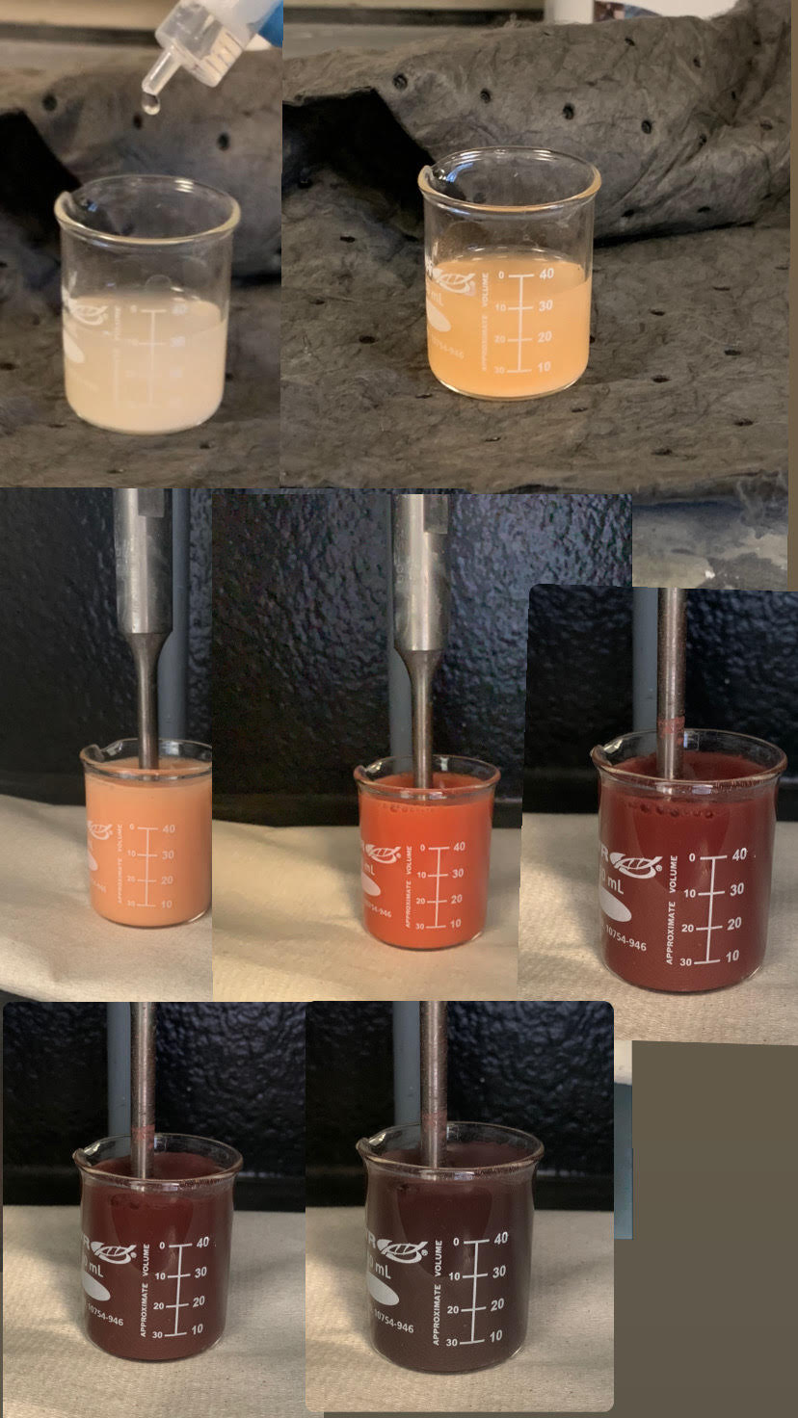
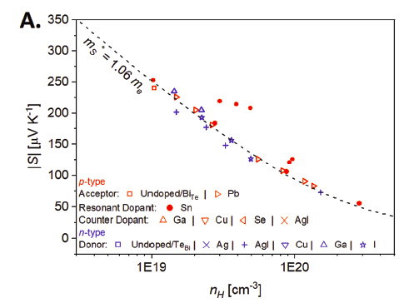
Electrical Constraints for Optimization

Slide 18
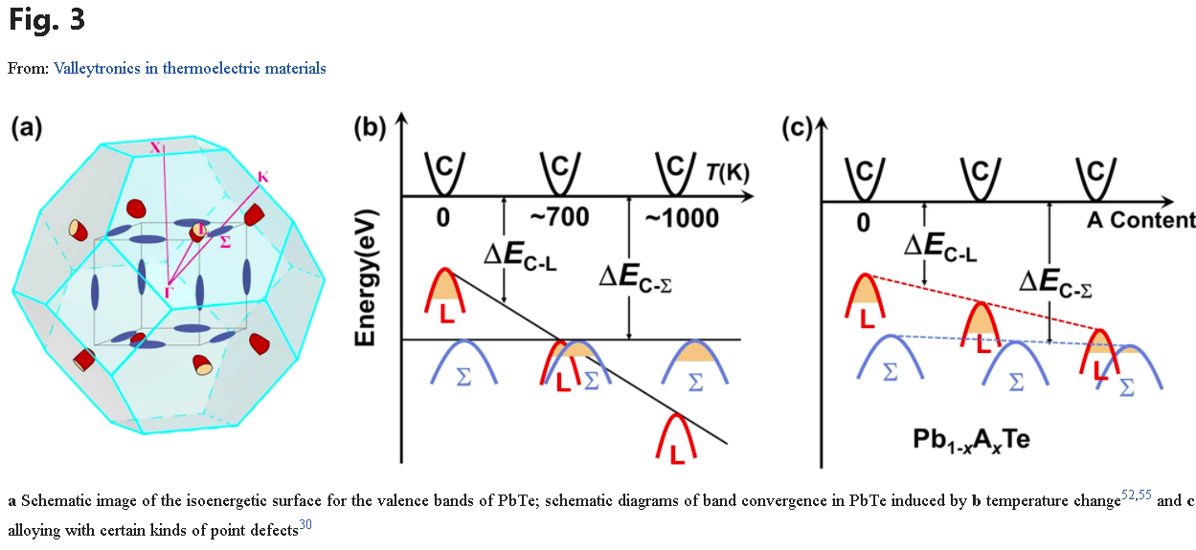

Slide 19
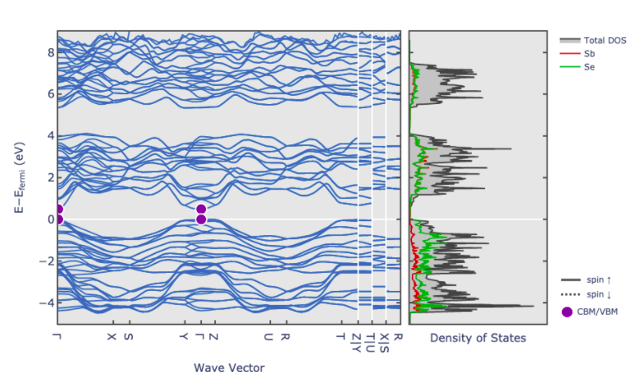
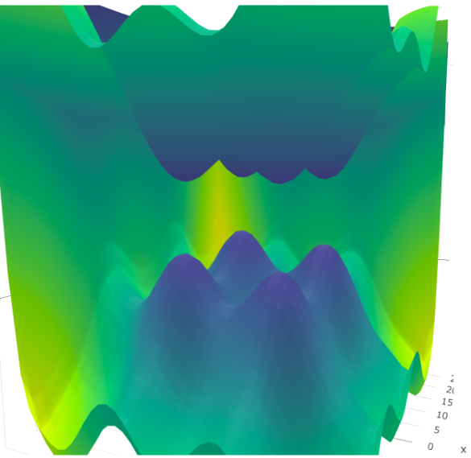
Limitation of Electron States Creates 3-D Topological Insulation
Notes:
Limitation of Electron States Creates 3-D Topological Insulation
Electric field is expelled from the internal bulk of material. Limitation of phonons

Slide 20
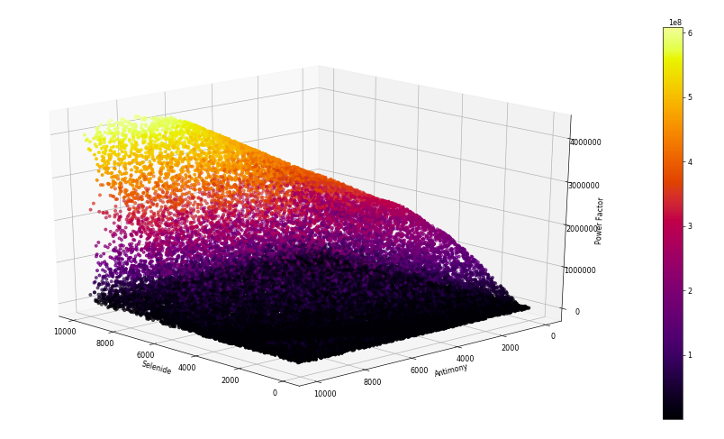
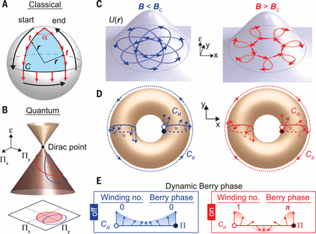

Slide 21
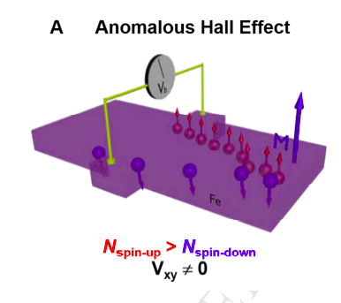
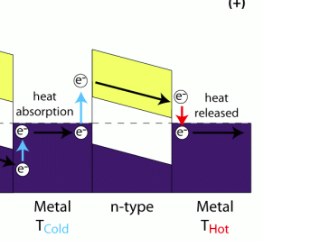

Slide 22
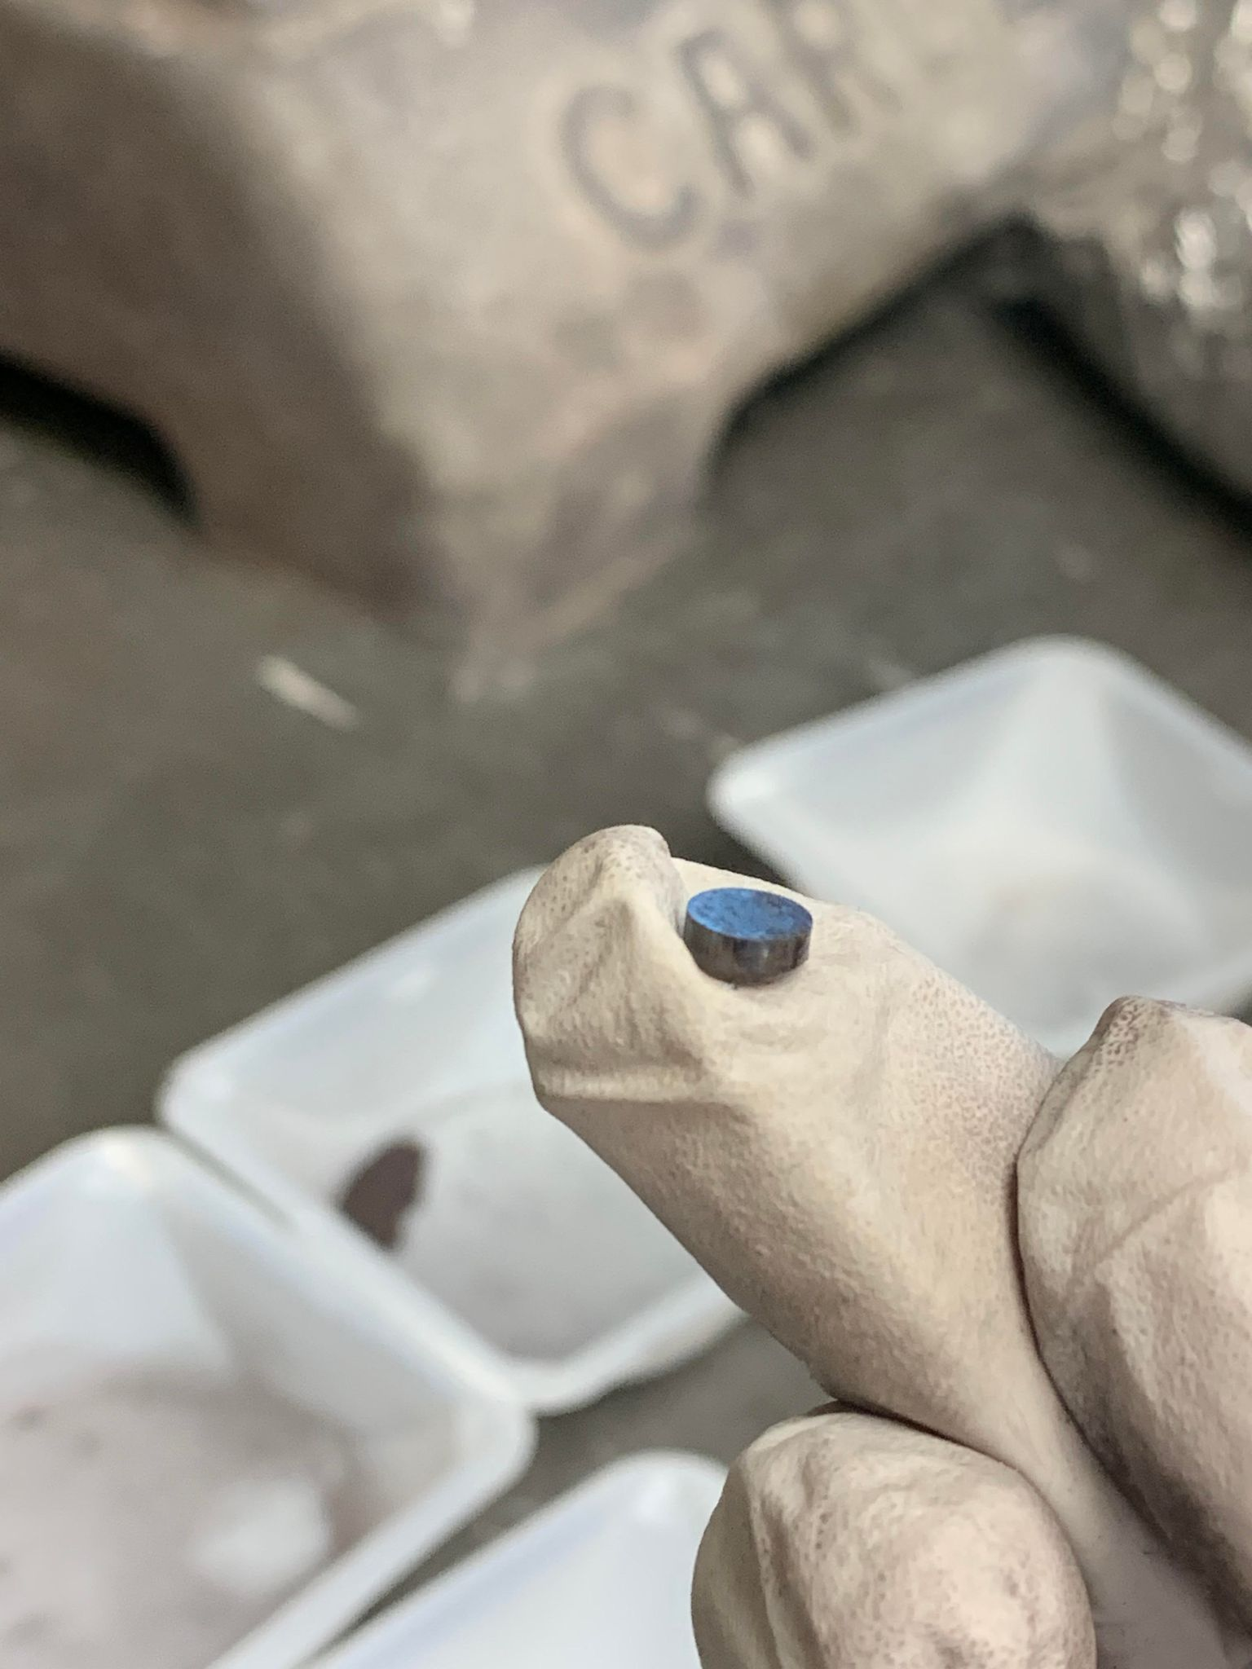
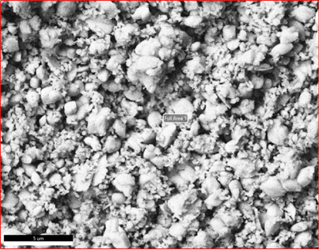
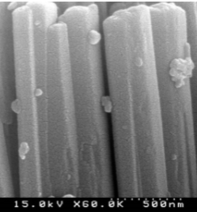
Nano-Physical Constraints for Optimization

Slide 23
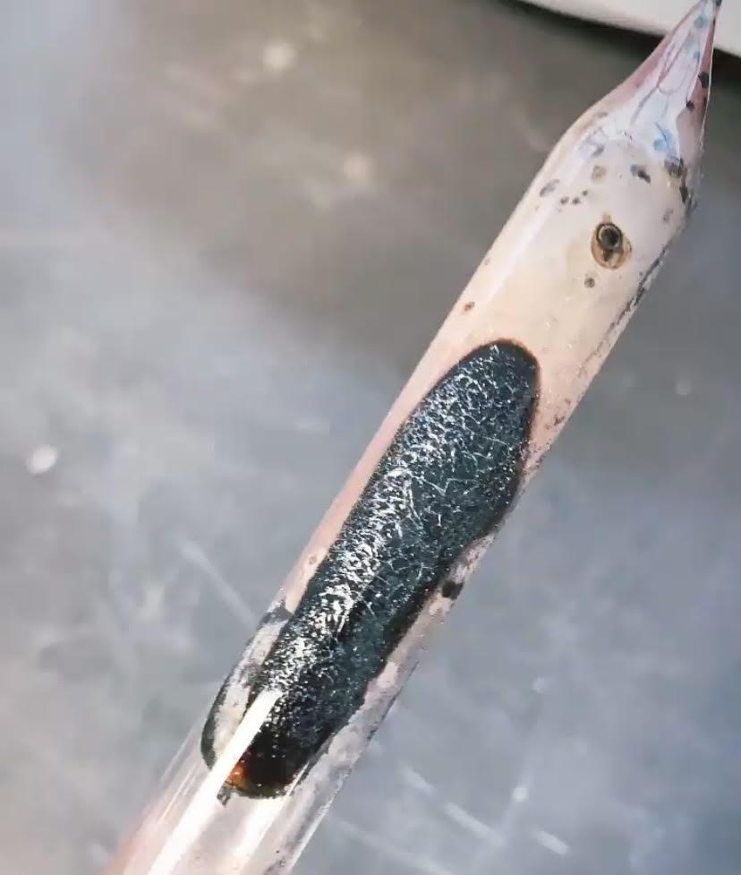
RECAP:
maximizing surface area
limit phonon conduction and maximize electron conduction
band gap maximizes Infrared absorption and creates the band inversion affect.
Doping carrier density maximizes band inversion overlap

Slide 24
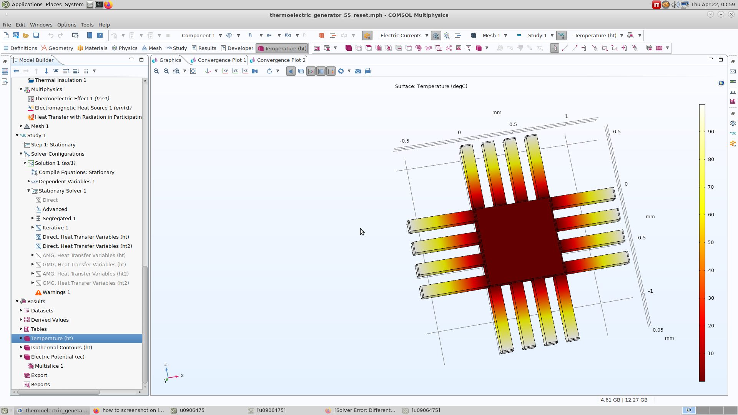
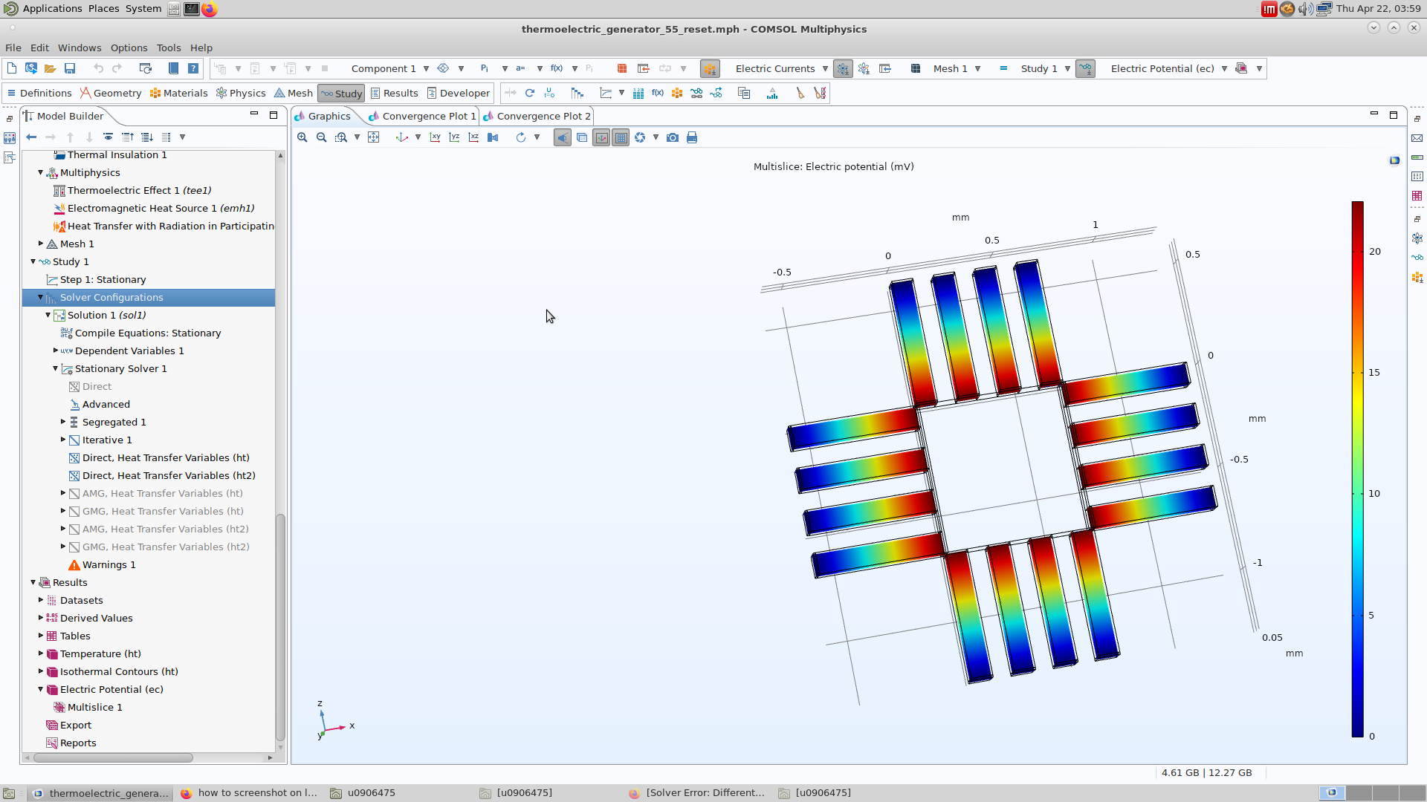

Slide 25
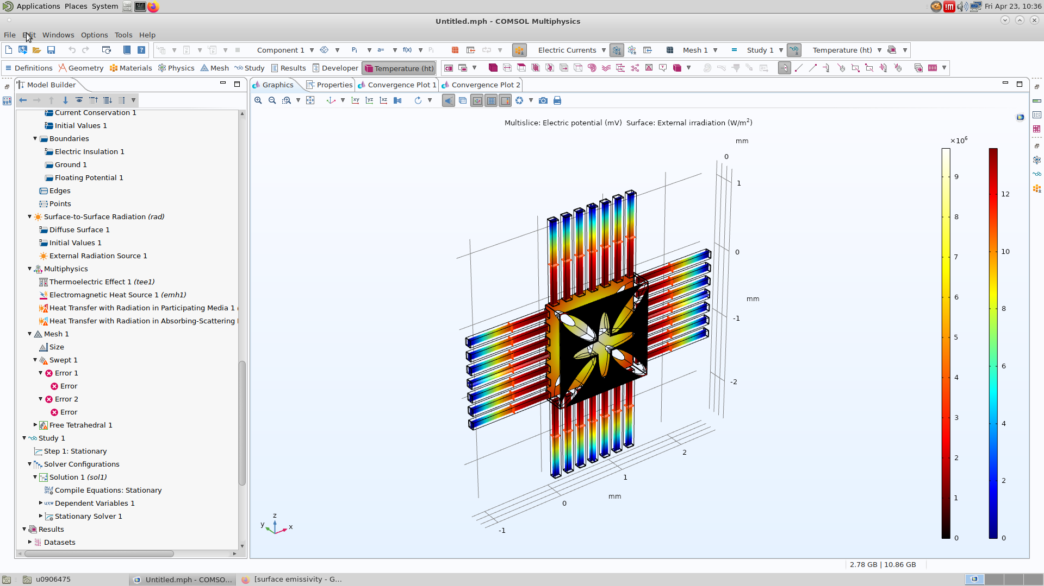

Slide 26
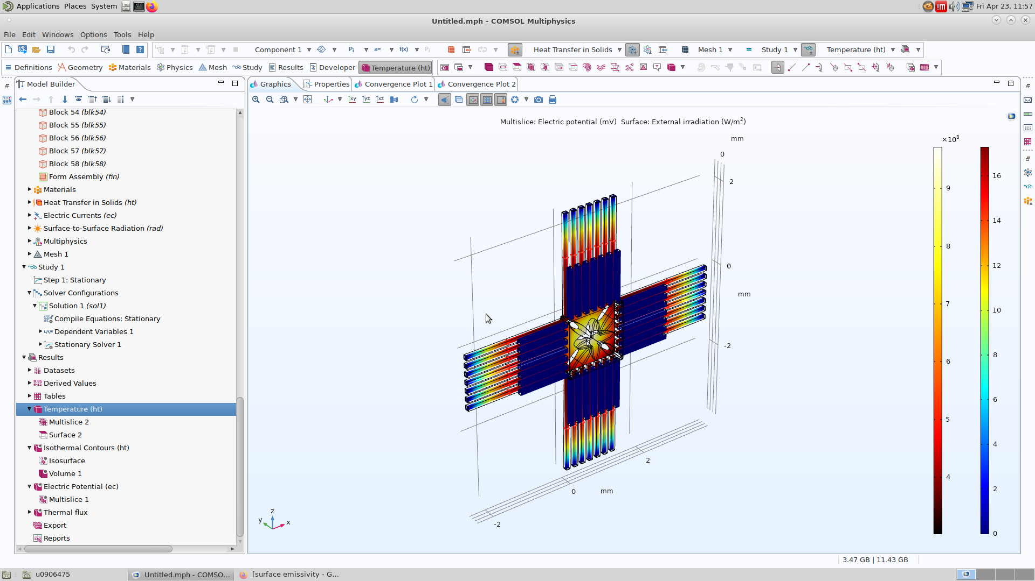

Slide 27
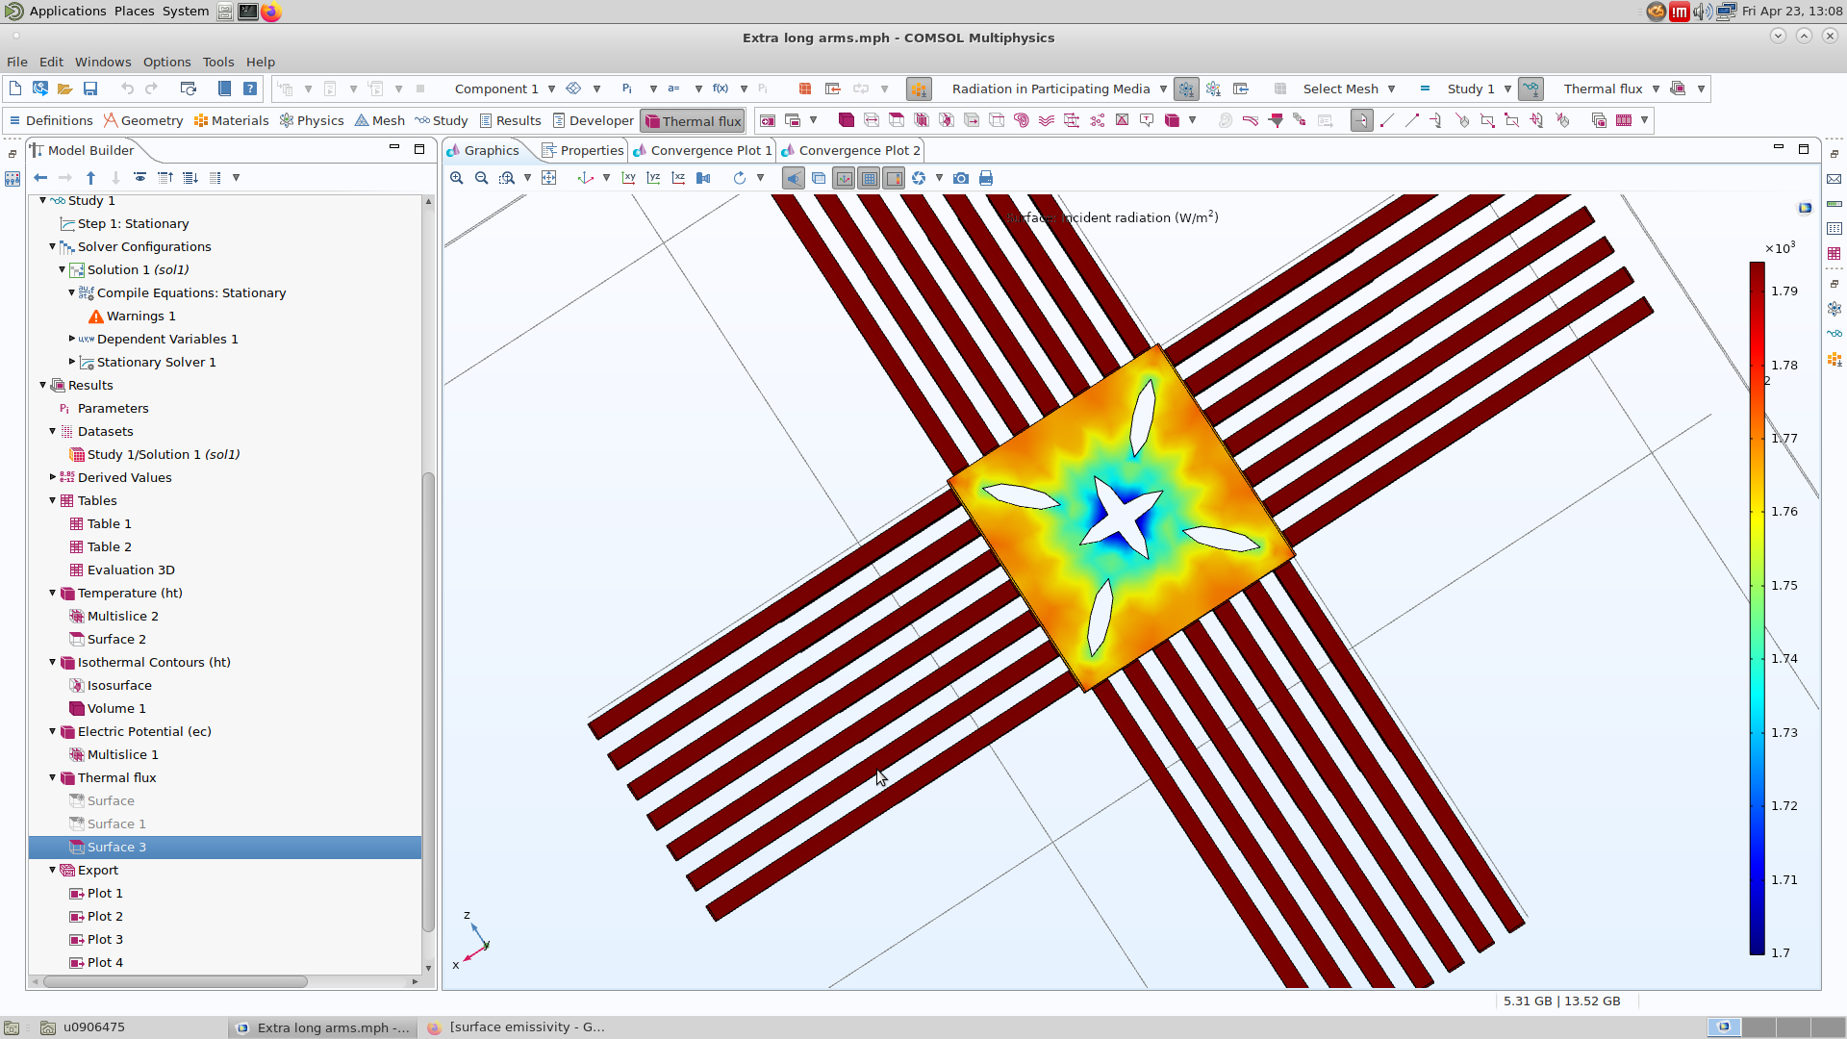

Slide 28
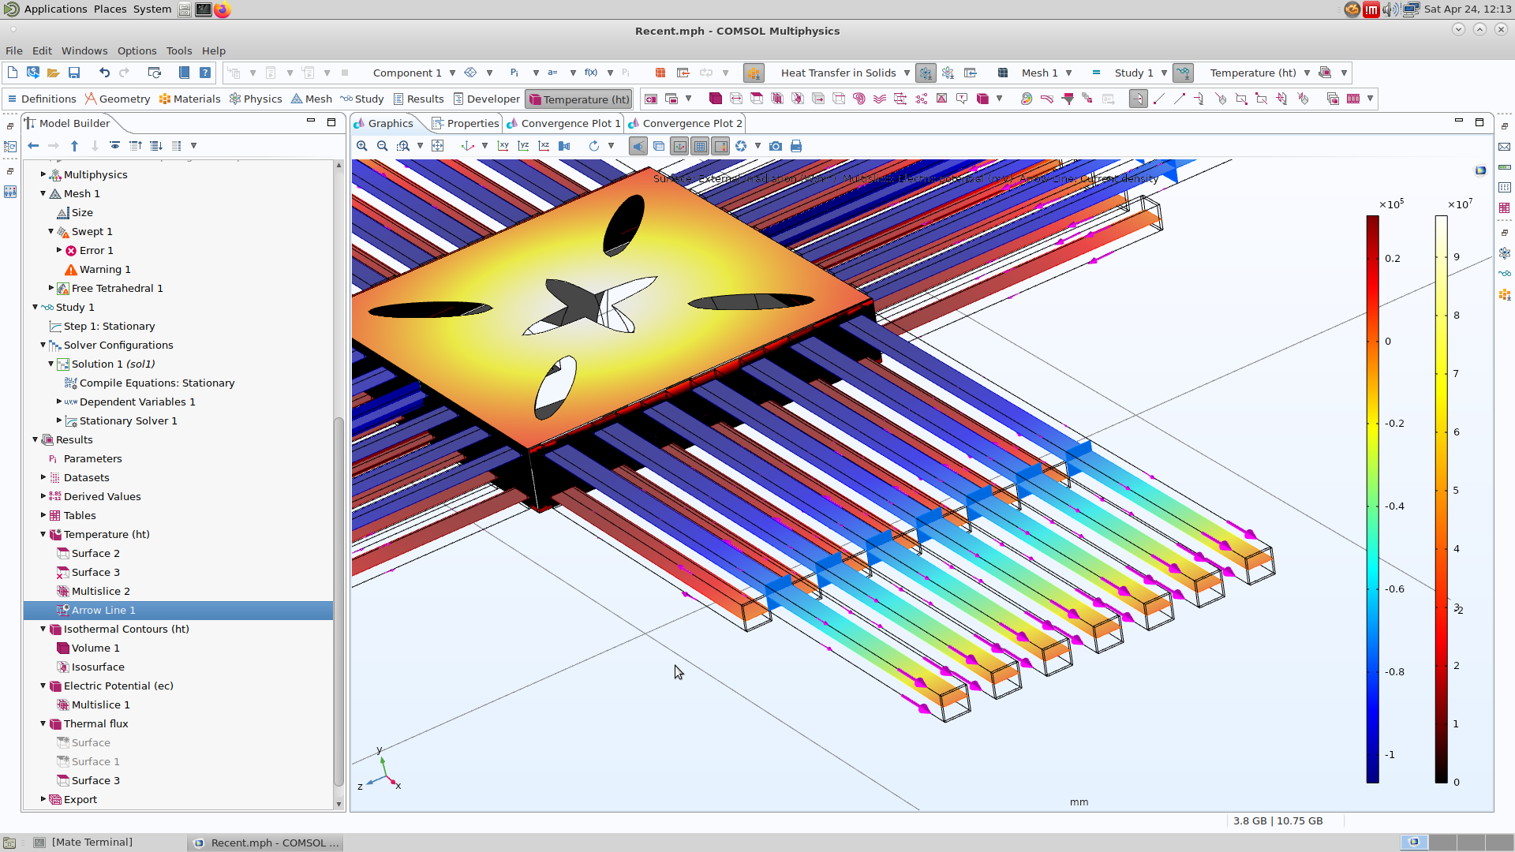

Slide 29
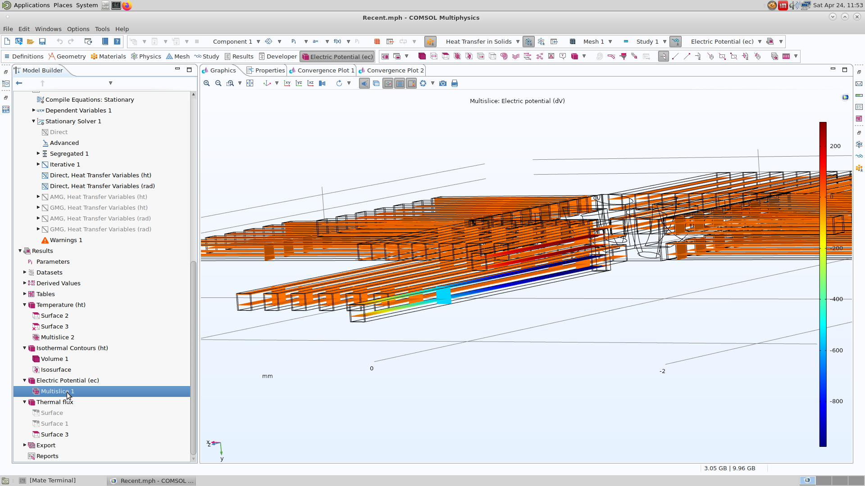

Slide 30
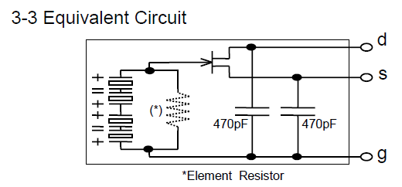
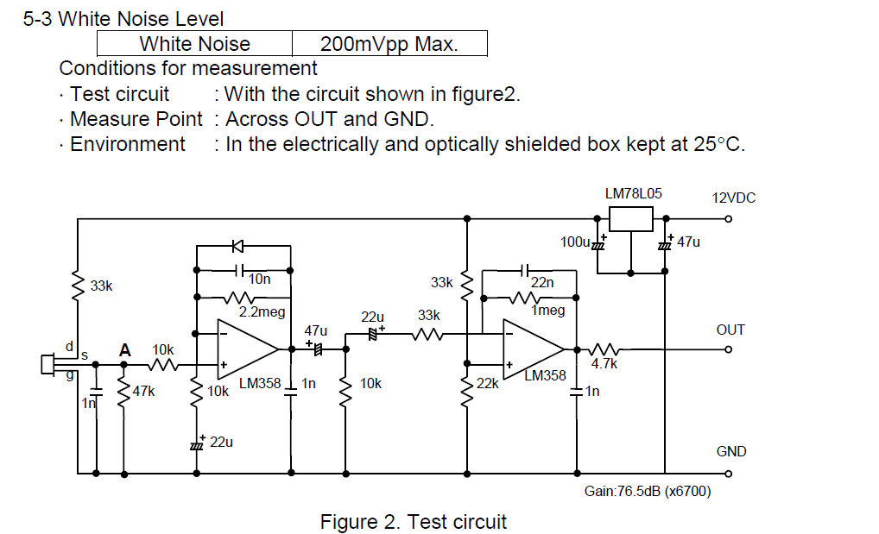

Slide 31
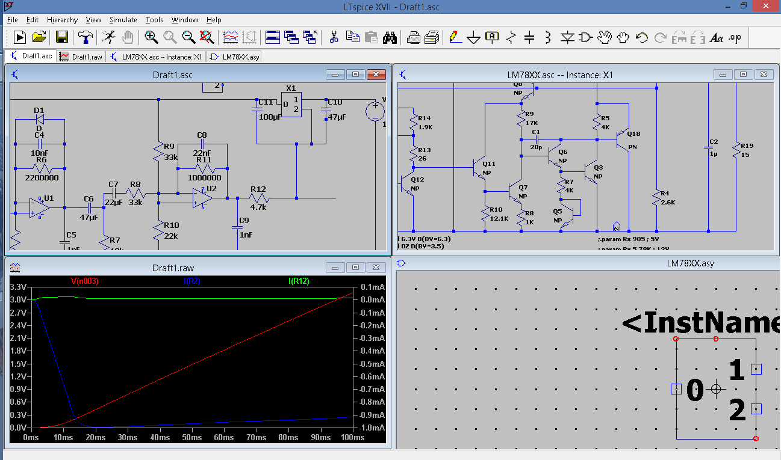

Slide 34
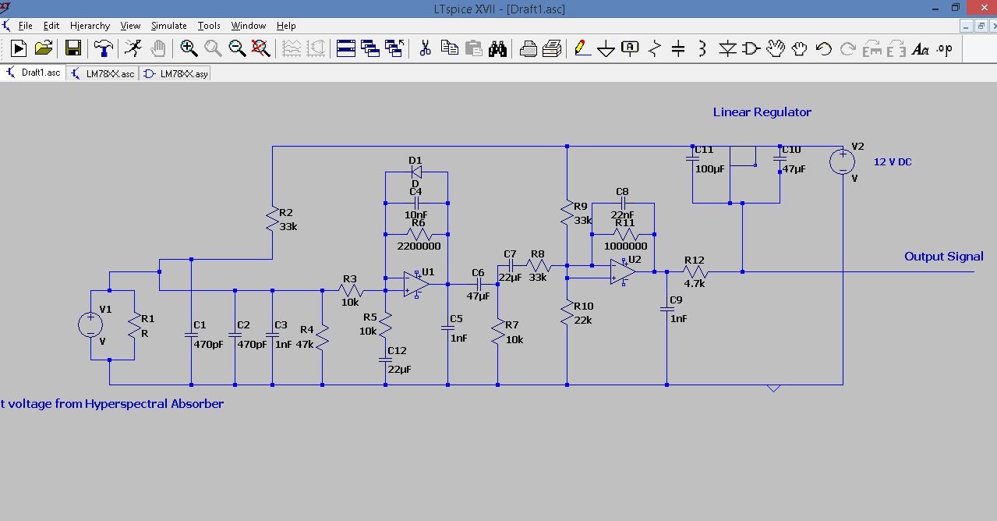

Slide 35
Selection of Manufacturing Process -IR
 | Pros | Cons
Front-Side etching | Economic | Limited thermal isolation, More Stiction
Back-Side etching | Higher performance | Double Sided Lithography, Expensive
KOH wet etchant | Anisotropic Backside etch | Size limited, Stiction,
XeF2 gas phase etchant | High Silicon selectivity, High release Isotropic | Not suitable for all materials
TMMA wet etchant | Anisotropic, Frontside etch | Stiction
DRIE | Isotropic | Thermal Bulging, Expensive
Notes:
[100] direction window for anisotropic etching
is faster than a [110] direction window on a (100) Si wafer.
As a silicon etchant, XeF2 presents unique advantages, such as high selectivity for silicon, gas phase isotropic etching, and ease of operation. Thus, XeF2 etching can avoid the stiction problem in the wet etching process and the plasma damage in the DRIE process; consequently, XeF2 etching is suitable for CMOS-MEMS thermoelectric IR sensors. Xu et al. [36] developed a CMOS-MEMS thermoelectric IR sensor by XeF2 front-side isotropic etching; the maximum transconductance change of the CMOS device after XeF2 etching was 1.25%.

Slide 36
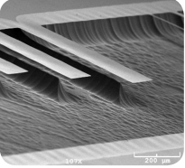
CVD, P ion diffusion,
photo etch mask
Laser Pulsed CVD
CVD, B ion diffusion,
photo etch mask
Plasma Enhanced CVD
Plasma Enhanced CVD
Aluminum Sputtering
Ion Beam Etch
XeF2 or TMMA wet etch
[5]

Slide 37
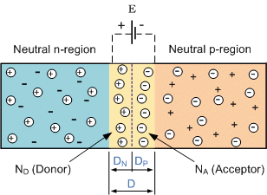
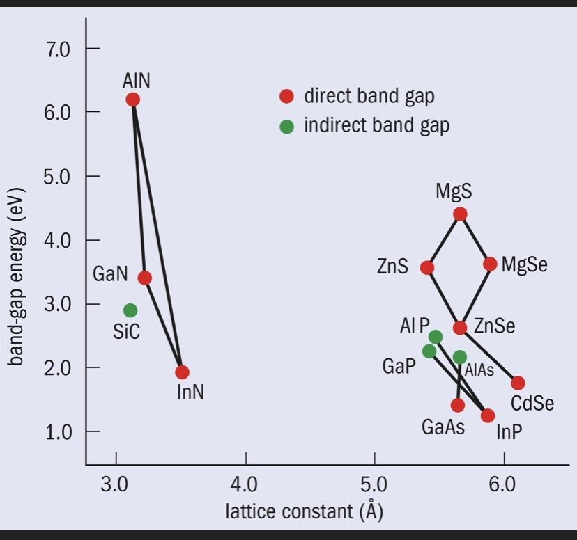
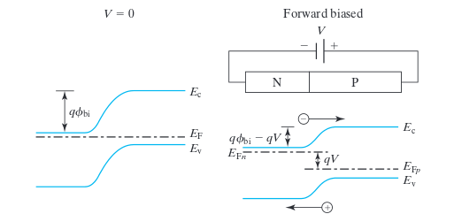
Similar but Different Working Principles:
Visible -

Slide 38
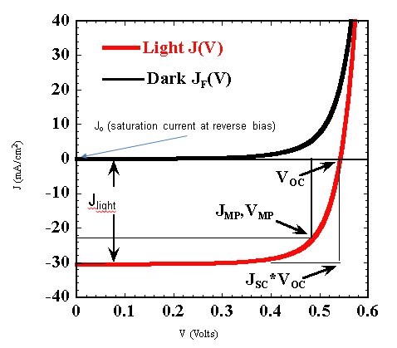
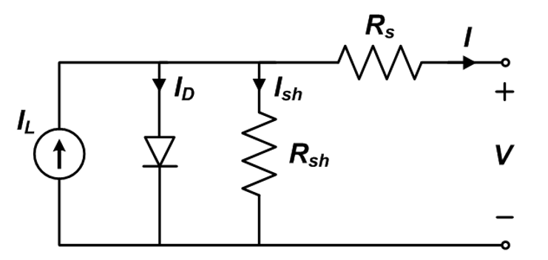
Visible -

Slide 39
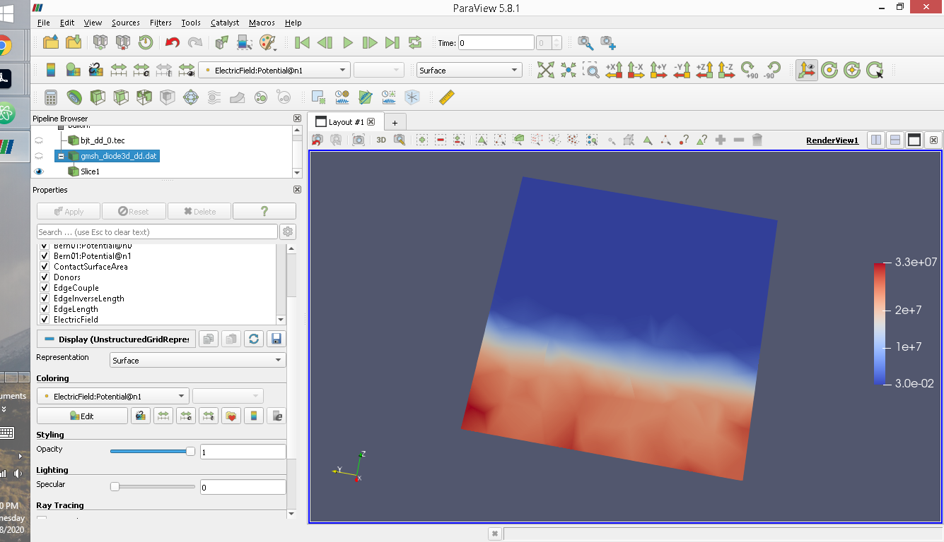
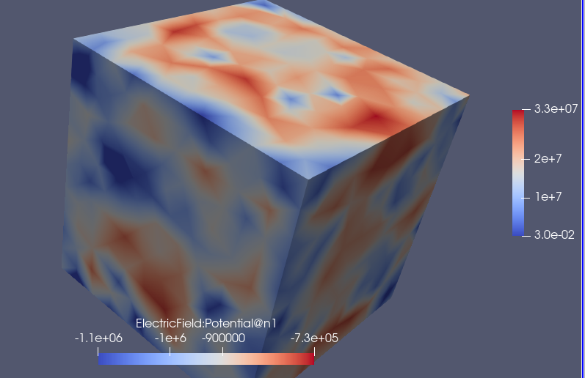


Notes:
Scaps simulator Devsim Paraview

Slide 40










Manufacturing Process -Visible
Source: PVEducation

Slide 41

N-type emitter

Slide 42



Slide 43


Slide 44



Slide 45
Packaging Considerations
Protect membrane from mechanical damage,dust, and fingerprints
Be able to be selective over desired wavelength
Notes:
Wafer method is selected one

Slide 46


Slide 47


https://semiengineering.com/whats-what-in-advanced-packaging/

Slide 49


Packaging

Slide 50


Design Verification

Slide 51


Design Verification

Slide 52

Microcontroller Circuit
IR Window
Casing
Thermoelectric

Slide 53
References
[1] https://link.springer.com/content/pdf/10.1007%2Fs11465-017-0441-2.pdf
Xu, D., Wang, Y., Xiong, B. et al. MEMS-based thermoelectric infrared sensors: A review. Front. Mech. Eng. 12, 557–566 (2017). https://doi.org/10.1007/s11465-017-0441-2
[2] https://www.mdpi.com/2072-666X/10/6/413
Doan, A.T.; Yokoyama, T.; Dao, T.D.; Ishii, S.; Ohi, A.; Nabatame, T.; Wada, Y.; Maruyama, S.; Nagao, T. A MEMS-Based Quad-Wavelength Hybrid Plasmonic–Pyroelectric Infrared Detector. Micromachines 2019, 10, 413. https://doi.org/10.3390/mi10060413
[3]https://www.spiedigitallibrary.org/ebooks/TT/Fundamentals-of-Infrared-Detector-Materials/eISBN-9780819478740/10.1117/3.741688?SSO=1
Kinch, Michael A. Fundamentals of Infrared Detector Materials. Bellingham: SPIE, 2007. Web.
[4] Kasper A. Borup, Johannes de Boor, Heng Wang, Fivos Drymiotis, Franck Gascoin, Xun Shi, Lidong Chen, Mikhail I. Fedorov, Eckhard Müller, Bo B. Iversen, G. Jeffrey Snyder “Measuring Thermoelectric Transport Properties of Materials” Energy and Environmental Science 8, 423 (2015)

Slide 54
References
[5] Welbourne, Dustin J., et al. "How do passive infrared triggered camera traps operate and why does it matter? Breaking down common misconceptions." Remote Sensing in Ecology and Conservation 2.2 (2016): 77-83.
[6] Huchuan Zhou et al 2013 J. Micromech. Microeng. 23 065026
[7] https://authors.library.caltech.edu/70797/4/nnano.2017.87-s1.pdf
[8] https://core.ac.uk/download/pdf/77926966.pdf

